Slide 1
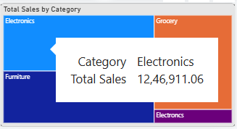
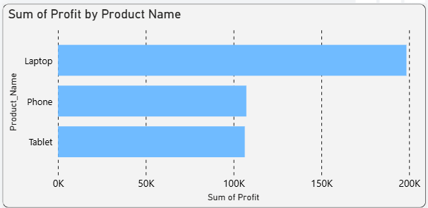
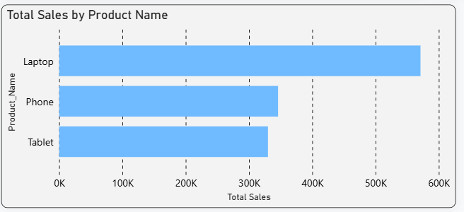
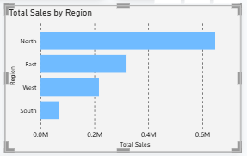
ABC Retail And Sales Report
Best Product category -Electronics
Highest Selling Product: Laptop (≈ 570K Sales)
Most Profitable Product: Laptop (≈ 200K Profit)
Business Impact: High demand combined with high profitability makes laptops the company's flagship product and a key driver of overall business performance.
Sales by Region
Highest Sales by Region – NORTH ( Sales = 0.6 M)
Lowest Sales by Region – South (Sales = 60 K)

Slide 2
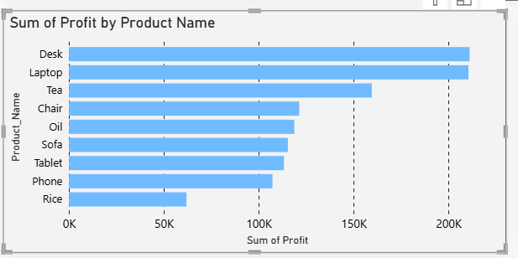
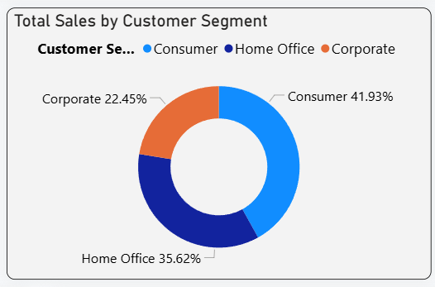
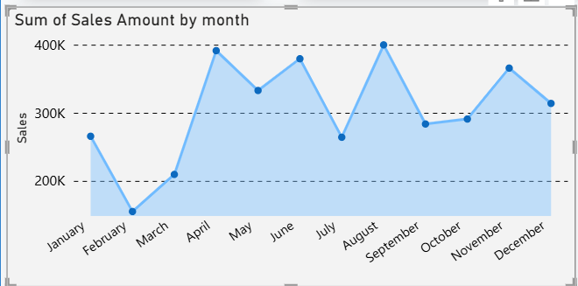
Most Profitable Product – Desks- (Profit – 200K)
Highest Revenue by Customer Segment – Consumer ( Sales Amount = 1.5 M [ 41%]
Seasonal trends in Sales –
From April to June sales are high and July to August are High

Slide 3
Three actions to improve business performance –
Focus on the Consumer Customer Segment
The Consumer segment generates the highest revenue for the company. The business should target this segment with personalised offers and marketing campaigns to increase sales and customer loyalty.
Increase Inventory Before Peak Seasons
Sales are higher during certain months due to seasonal demand. The company should stock more inventory before these peak periods to avoid stock shortages and maximise sales opportunities.
Focus on High-Performing Products
Since Laptop is the highest-selling and most profitable product, the company should increase its stock and continue promoting it through marketing campaigns. This will help increase both sales and overall profit.

